Slide 1




VG EXPERT TAX ADVISORS LLP
GLOBAL ACCOUNTING
TAXATION
FINANCIAL STRATEGY
Your Trusted Financial Partner for Growth & Compliance Serving Clients in India, USA, UK and Dubai.
www.vgtaxadvisors.com

Slide 2
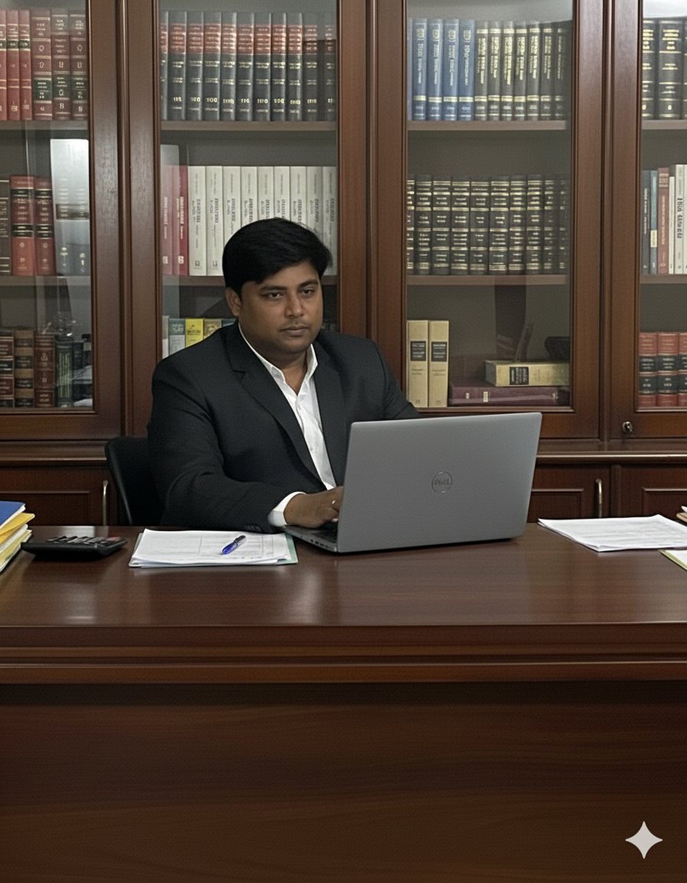
OUR STORY
From Local Roots to Global Reach
VG Expert Tax Advisors LLP is a premier accounting and financial consultancy firm with a legacy of excellence spanning over a decade.
The journey began in 2015 when our founder, Mr. Gajanand Agarwal, established AG Associates. Through a commitment to precision and client success, the firm grew substantially over the last 10 years.
Today , We are a robust team of 40+ financial professionals operating out of three strategic branches in Hyderabad (Bowenpally, Madhapur, Abids). We currently manage over 300+ clients across diverse industries in India and are rapidly expanding our global footprint, successfully handling accounting and compliance for clients in the USA, UK and Dubai.

Slide 3
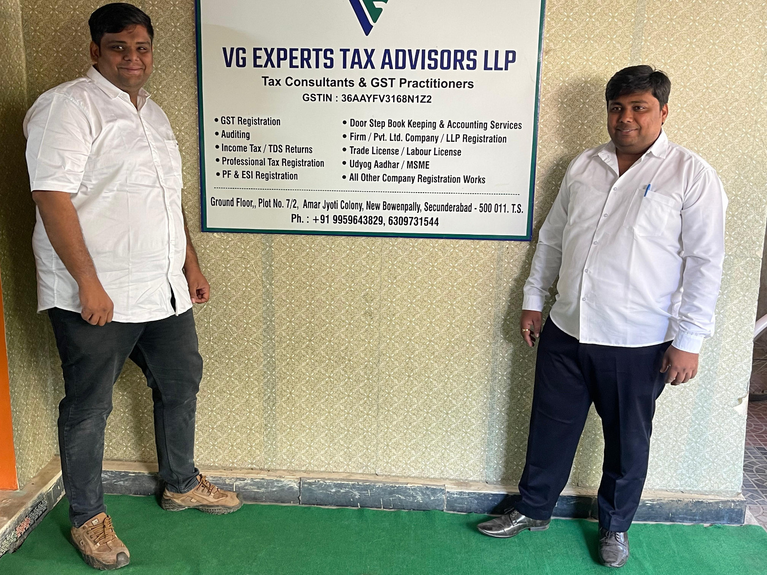
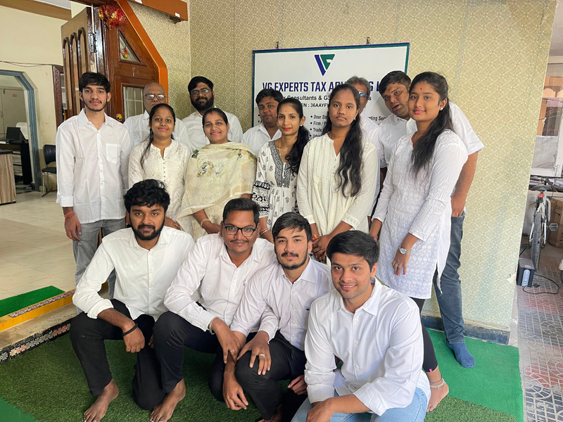
OUR MISSION
To provide businesses with high quality, cost-effective, and scalable accounting solutions, allowing you to focus on core business growth while we handle the numbers.

Slide 4





THE VG ADVANTAGE FOR USA CLIENTS
WHY PARTNER WITH US?
As a US-based business, outsourcing your financial operations to VG Expert Tax Advisors offers you a strategic competitive edge:
Global Expertise
Cost Efficiency
Senior Leadership
Technology Driven
Scalability
With experience of serving clients in the USA, UK and Dubai, we understand international accounting standards and cross-border financial nuances.
Reduce your operational overhead significantly without compromising on quality or turnaround time.
Unlike standard outsourcing firms, our operations are led directly by partners with 10-12+ years of experience, ensuring high-level oversight on your accounts.
We utilize top-tier cloud accounting software (Quick Books, Xero, Zoho, etc.) to ensure real-time collaboration and transparency.
Whether you are a startup or an established corporation, our team size of 40+ members ensures we can scale our services to match your growth immediately.

Slide 5
SERVICES WE PROVIDE
We offer end-to-end support tailored to US Accounting Standards (US GAAP) and tax requirements:
Outsourced Bookkeeping &
Accounting
Audit Support & Assurance
  Preparing financial statements for audits.
  Internal control reviews and risk assessment.
  Day-to-day bookkeeping
(AP/AR management).
  Bank and Credit Card Reconciliations.
  General Ledger maintenance.
  Monthly, Quarterly, and Annual closure of books.
Business Setup & Consultancy
Our team handles rigorous audit standards for 300+ clients, ensuring your books are audit-ready at all times.
  Entity formation and structuring.
  Strategic financial consulting for business expansion.
Taxation Support (US & International)
Virtual CFO & Management
Reporting
  Preparation of tax returns for individuals and corporations.
  Tax planning and compliance support.
  Assistance with SALES TAX and international tax treaties.
  Financial forecasting and budgeting.
  Cash flow management and analysis.
  Customized MIS Reports for better decision-making.

Slide 6
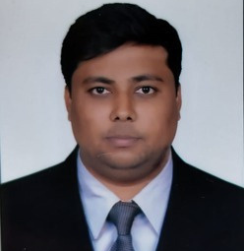
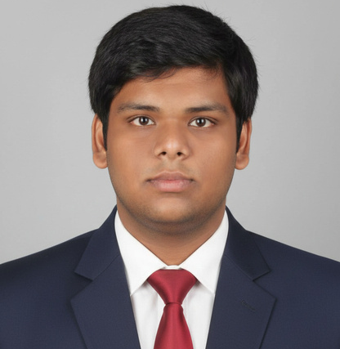
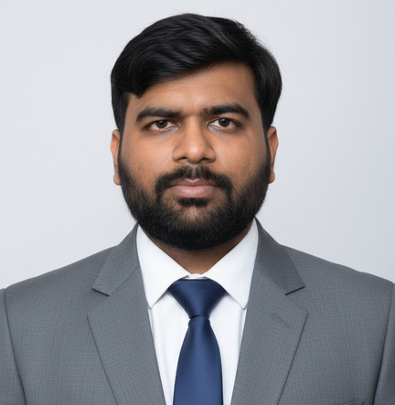
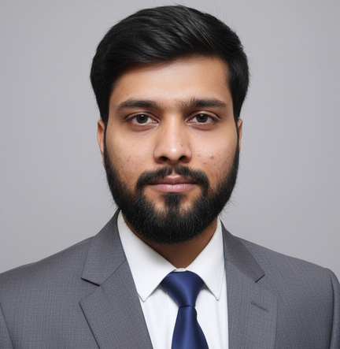
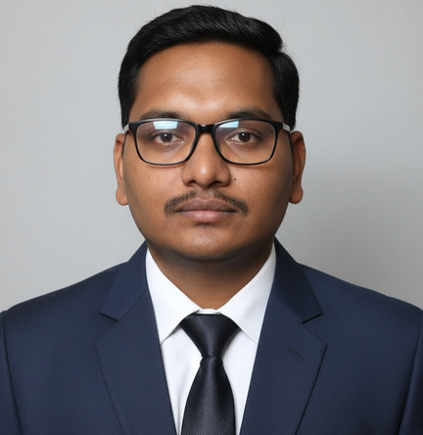
MEET THE PARTNERS
Outsourced Bookkeeping & & Accounting
Gajanand Agarwal
Founder
Vipul Hindocha
Partner
Rajat Bhoot
Partner
Nischay Malyaan
Partner
Goutham Reddy
Partner
Founder of AG Associates (2015). a visionary leader with deep expertise in taxation and strategic business grown
Expert in international taxation and corporate compliance.
Specializes in statutory compliances, GST, and Income Tax, with extensive experience managing SME businesses since 2012.
Leads audit and assurance verticals with a focus on operational efficiency and risk management.
Expert in financial planning and management consulting for diverse industries.

Slide 7






INDUSTRIES WE SERVE
Information Technology (IT) & SaaS
Retail, Wholesale & E-commerce
Real Estate & Infrastructure
Manufacturing & Textiles
Logistics & Shipping
Financial Services

Slide 8

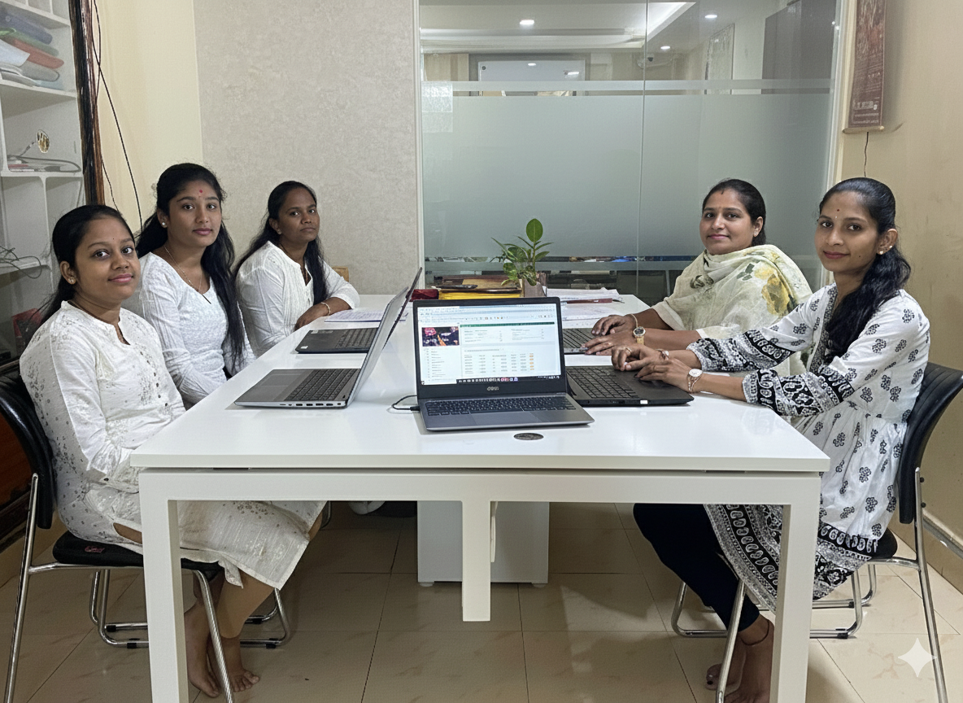



OUR KEY CLIENTELE
Franchisee Accounts
We manage accounting, taxation, and compliance for leading national and international franchise brands, ensuring smooth financial operations across multiple locations

Slide 9




OUR KEY CLIENTELE
Direct Corporate Clients
We work closely with growing enterprises and established organizations, providing tailored financial solutions aligned with their industry needs.
Shree Shyam Steel
Deepak Ispat
Synycs Group
Aqua Diamond
Park Lane Hotel
Watertech Engineering

Slide 10
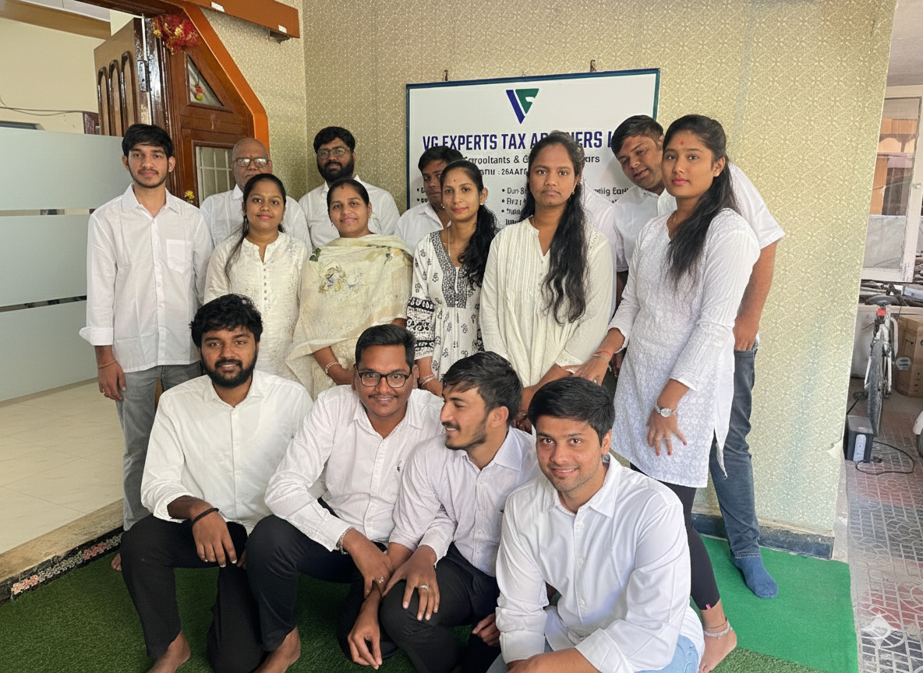
OUR TEAM
Behind our success is a dedicated team of 40+ professionals, including Chartered Accountants, Tax Experts, and Junior Associates. We foster a culture of continuous learning to stay ahead of global financial trends.

Slide 11
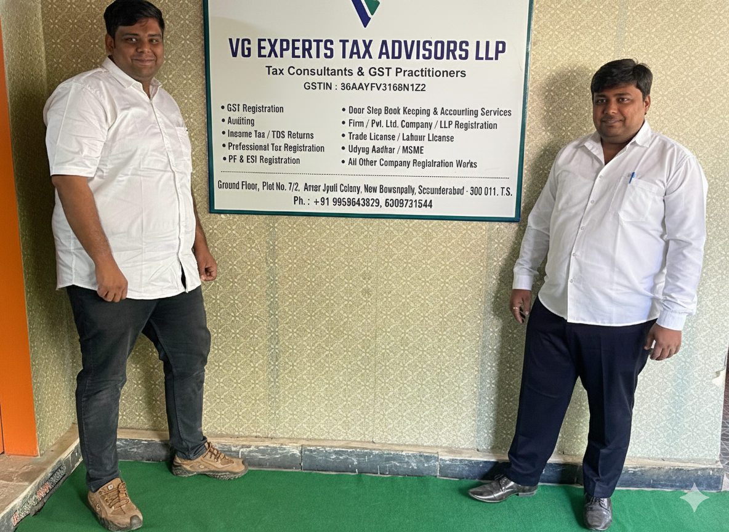




CONTACT US
Ready to optimize your accounting? Let’s talk.
+91 63008 35346
www.vgtaxadvisors.com
Bowenpally || Madhapur || Abids
contact@vgtaxadvisors.com
hyd.agassociates@gmail.com

Slide 12
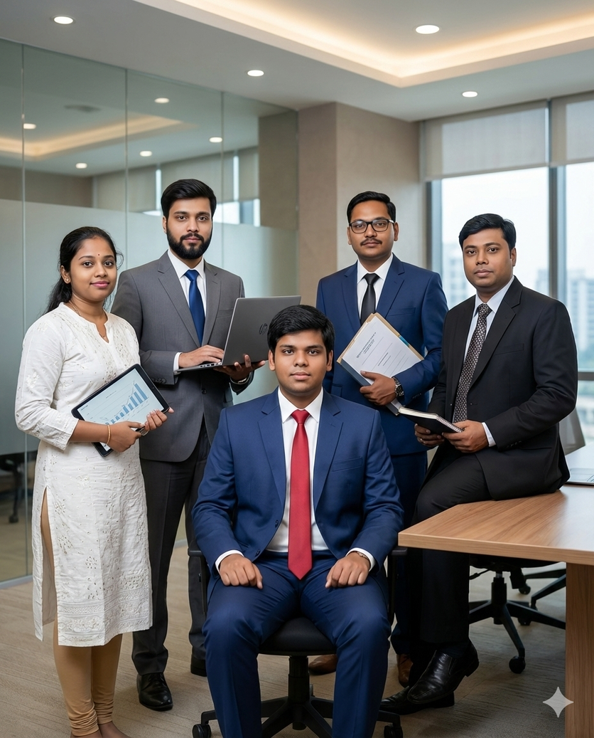

VG EXPERT TAX ADVISORS LLP
THANK YOU
FOR ATTENTIONS
We would like to express our sincere appreciation for your time and consideration in reviewing our business plan. We are excited about the potential opportunities ahead and look forward to the possibility of working together in the future.
www.vgtaxadvisors.com

